Slide 1
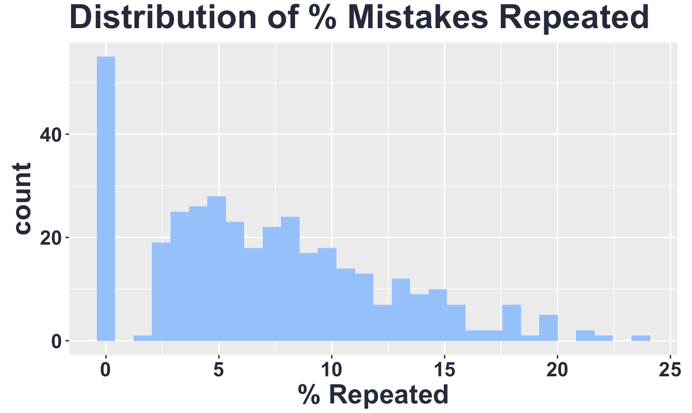
Unlocking Feedback Generalization: How metacognitive Interventions reduce Repeated Mistakes
Xinhui Zhang, Sydney Wood, Victoria Cross
Background
Results
Conclusion
Metacognition—thinking about one’s own thinking– is widely linked to self-regulated learning and higher achievement. Although Wood & Cross(2024) showed that the metacognitive intervention raised exam scores in prior research research the mechanism of improvement remained unclear. In this study, using data and rubric-level error counts from 369 undergraduates in five scaffolded research-methods exams, the present study test 3 questions: 1) Overall, do students make fewer repeated mistakes when repeatedly tested on concepts? 2) Does feedback viewing behavior on Exam X predict the number of repeated mistakes on Exam X+1? 3) Does the number of
Repeated mistakes between the two groups differ before versus after the intervention when controlling for feedback viewing behavior?
Prediction
Hypothesis 4A: Overall, exam performance increases on concepts that are repeatedly tested.
Hypothesis 4B: Students who view feedback make fewer repeated mistakes on subsequent exams than those who did not view feedback.
Hypothesis 4C: Controlling for feedback viewing, students in the intervention group make fewer repeated mistakes on exams after the intervention controlling for feedback viewing behavior?
References
Reference one
Reference two
Reference three
Reference four
Reference five
Methods
Participants: 370 undergraduates in a research method course.
Intervention: Optional metacognitive exam corrections after Exam 3.
Measure:
Repeated mistakes (matched rubric items across scaffolded exams).
Analysis:
For Hypothesis 4A: Multilevel model to test whether the percent of repeated mistakes differed based on the number of previous time a question was answered.
For Hypothesis 4B & 4C: Use multilevel model to compare the percentage of repeated mistakes.

